Slide 1
Federal-Mogul Goetze (India) Limited
Investor Presentation and Q1 FY22-23
Financial Results
August 11, 2022

Slide 2
Safe Harbor
Forward-Looking Statements
Statements in this document describing the Company’s objectives, projections, estimates and expectations may be “forward looking statements” within the meaning of applicable securities laws and regulations. Actual results could differ materially from those expressed or implied due to many factors. Important factors that could make a difference to the Company’s operations include, among others, economic conditions affecting demand/supply and price conditions in the domestic and overseas markets in which the Company operates, changes in the Government regulations, tax laws and other statutes and incidental factors. Unless otherwise indicated, the forward-looking statements in this presentation are made as of the date of this communication, and, except as required by law, Company does not undertake any obligation, and disclaims any obligation, to publicly disclose revisions or updates to any forward-looking statements. All market and industry data are based on Company estimates.

Slide 3
Federal-Mogul Goetze (India) Limited (“FMGIL”) was established in 1954 as a joint venture with Goetze-Werke of Germany, which was owned by Federal-Mogul LLC, one of the leading manufacturers of automotive components in the world.
Globally, Tenneco has 4 business groups viz. Performance Solutions, Motorparts, Clean Air and Powertrain. FMGIL’s products substantially falls under “Powertrain” business group.
Based in Gurugram (Haryana, India), FMGIL engages in manufacture, supply and distribution of automotive components in India and internationally.
Mainly offers pistons, piston rings, piston pins, valve seats, valve guides.
Caters to Automotive, heavy-duty, motorcycles, energy, industrial, power generation, railway & defence industries.
FMGIL manufactures world class products at its state of the art manufacturing facilities located at Patiala (Punjab), Bangalore (Karnataka) and Bhiwadi (Rajasthan).
FMGIL now operates as subsidiary of Tenneco Inc. post Tenneco’s acquisition of Federal-Mogul LLC.
Company Overview
Employees
5000+
as on 30th June, 2022
Facilities
03 Manufacturing sites 02 Sales Office
13 Warehouses
OEM Customers
30+

Slide 4
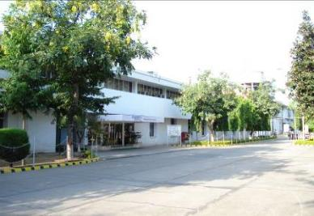
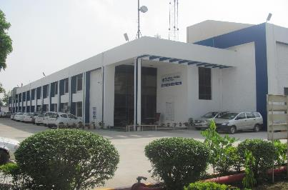
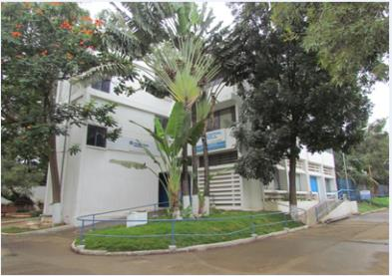
Manufacturing Facilities
Location: Bangalore, Karnataka
Area: Approx. 50 acres
Product: Pistons, Pins and Rings
Established: 1977
IATF16949, ISO14001, ISO 45001
Location: Patiala, Punjab
Area: Approx. 60 acres
Product: Pistons, Pins and Rings
Established: 1954
IATF16949, ISO14001, ISO 45001
Location: Bhiwadi, Rajasthan
Area: Approx. 5.5 acres
Product: Valve Seats & Valve guides
Established: 1996
IATF16949, ISO14001, ISO 45001

Slide 5
Shareholding pattern as on 30th June, 2022
Shareholding Breakup
*h* ’Others’ include 1.6178% Mutual Fund and 0.04300% FIIs/FPIs

Slide 6
Board of Directors
Mr. K. N. Subramaniam, Chairman & Independent Director
Mr. Vinod Kumar Hans, Managing Director
Dr. Khalid Iqbal Khan, Whole Time Director-Legal & Company Secretary
Mr. Manish Chadha, Whole Time Director-Finance & Chief Financial Officer
Mr. Rajesh Sinha, Whole Time Director
Mr. Sunit Kapur, Director
Mr. Stephen Shaun Merry, Director
Ms. Nalini Jolly, Independent Director
Mr. K. C. Sundareshan Pillai, Independent Director

Slide 7





Competitive Strength
Credit Rating
R&D Centers
Global Edge
Supply
Long term A+ and Short term A1+
In-house Technical Centers at Bangalore & Bhiwadi
Seamless Technology transfer
Supply to all major OEMs
Segment
Liquidity
Team
Well diversified segments
Strong financial liquidity
Highly experienced & talented team

Slide 8
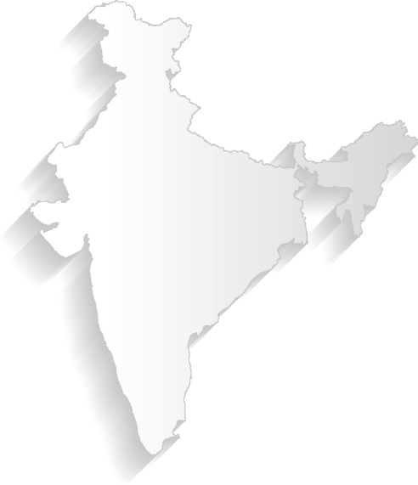




























Diversified Customers - OEM
Geographical Presence
INDIA
Bengaluru: Pistons, Rings
Bhiwadi: VSG
Patiala: Pistons, Rings
TECHNOLOGY CENTER
MANUFACTURING SITE

Slide 9
Revenue mix by Market segment
Revenue split by market
Revenue split by Segment
Passenger Vehicles
Aftermarket & OES
2/3 Wh
Commercial Trucks, LCV, Off- Highway, Industrial & Others
Overall revenue diversified in all market segment
Serving to all major OEMs in various segment
Revenue : FY 2021-22
For the Q1 the export share has reduced to 9% because of European situation and slow down in US Aftermarket
60% non-OE PV and 2 Wh
Revenue : FY 2021-22
60% revenue from non-OE PV and 2Wh
Commercial Truck and Off-Highway (CTOH)
Notes:
More than 50% of the business is not impacted by electrification.

Slide 10
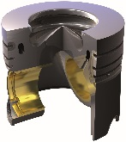
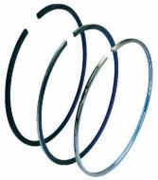
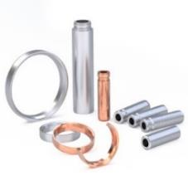
OEM market position in India
Pistons
Piston Rings
Valve, Seats & Guides
#2 Overall
#1 Diesel Pistons
#1 Overall
#1 Overall

Slide 11
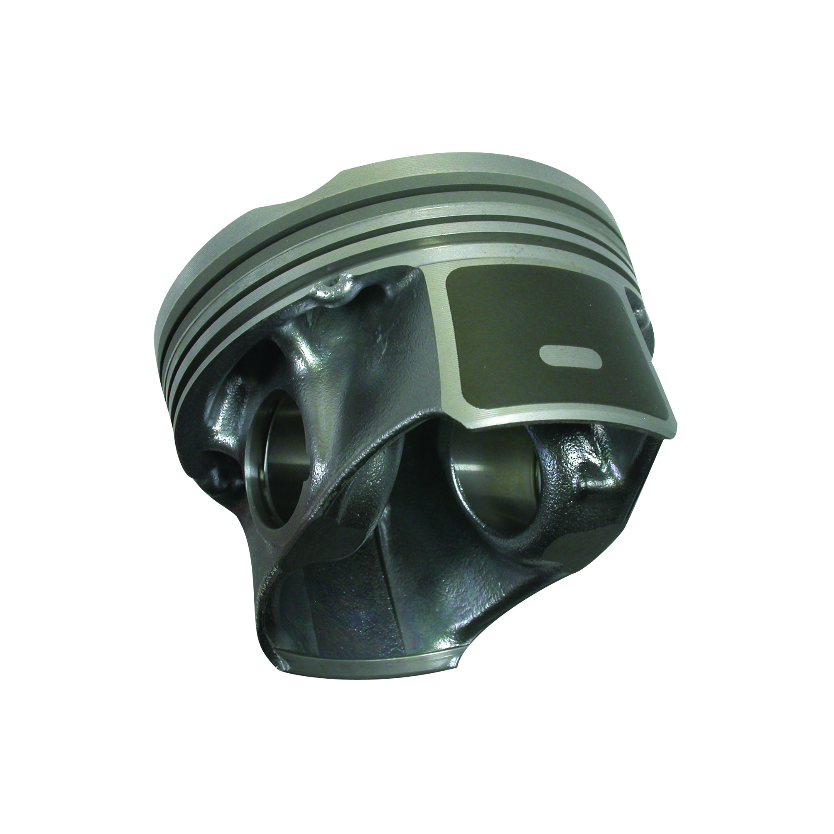
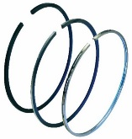
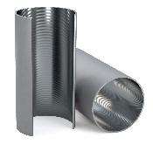
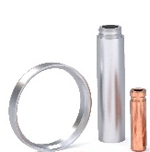
Powertrain Segment
Key Drivers And Technologies
Better Fuel Economy
Durability (Life)
Low Emission
Thermal Management
High thermal & Mechanical Strength, Longer Life (Fatigue)
Electrification/ Hybridization
Flex Fuel/Hydrogen
Wear & Corrosion Resistant
Less Pollution
Low Friction
Advanced Combustion
Advanced Gasoline Pistons
Heavy-Duty and Light Vehicle Pistons
Piston Rings
Cylinder Liners
Valve Seats and Valve Guides
Our components have a direct impact on engine performance, durability and emissions compliance
Technologies enable energy efficiency, reduce CO2 emissions and enhance durability

Slide 12






Customer Awards & Recognition
# | Customer’s Name |  | Received on | Appreciation / Award Type
1. | FIAT India |  | 2nd Apr 2021 | Best supplier Award for Good Quality Performance in 2020
2. | Mahindra & Mahindra (Automotive Division) |  | 12th Apr 2021 | Supplier Excellence Award for the “Best Product Development Performance” 1. Commodity Award in Engine Proprietary for AD 2. Best Product Development for AD 3. Best Spares Performance for AD
3. | General Motors |  | 30th Jun 2021 | “Supplier Quality Excellence Award” for the 9th consecutive year
4. | Mahindra & Mahindra (Automotive Division) |  | 13th Aug 2021 | Appreciation for XUV700 Product development support and valuable contribution in excellence execution
5. | Daimler AG |  | 12th Nov 2021 | Achieving overall “0 PPM“.
6. | John Deere |  | Q1, 2022 | Partner Level Supplier” award in Achieving Excellence Program
7. | KTM Austria |  | Dec, 2021 | Supplier Quality Award
8. | Toyota (TIEI) |  | Q2, 2022 | Achieving overall “0 PPM“.

Slide 13




Building a Stronger FMGIL
Performance Focus - Margin Expansion & Cash Generation
Reduce
Operational Cost
Lower Capital
Intensity
Growth Opportunities
Fixed Cost reduction
Operational efficiency
Improve capex/revenue ratio
Expand working capital turns
Inventory driven
Stringent Emission norms
Increased Popularity of TGDI to cope with emission regulations
Increase in production of mild-hybrid vehicles.
Major focus on commodity inflation recovery
Optimizing shareholder value creation through cash generation and targeted growth opportunities
13

Slide 14
Financials
Q1
FY2022-23

Slide 15
Financial Results for Qtr. Ended 30th June 2022

Slide 16
Financial Performance Qtr. Ended 30th June 2022

Slide 17
Financial Performance Qtr. Ended 30th June 2022

Slide 18
Financial Results Overview
High Points
Q1 Performance
Revenue of INR 3963 million was mainly driven by the growth in domestic market. However, it was impacted by slowdown in US and European markets, reducing the export share to 9% of the total revenue but growth in domestic market has more than compensated the reduction in exports.
EBITDA was INR 454 million versus INR 352 million of corresponding quarter of previous year. As a percent of Revenue, it was 11.3% Vs 11.0% in corresponding quarter of previous year. The current quarter was highly impacted by steep rise in commodity and global supply chain disruption resulting in significant increase in premium freight. However, currently the commodities have eased out to a comparatively lower level and the supply chain disruption has started settling down.
The Company reported a net profit after tax for the first quarter of INR 187 million.
The Company has cash & cash equivalent of INR 1529 million (June quarter cash generation - INR 293 million)

Slide 19
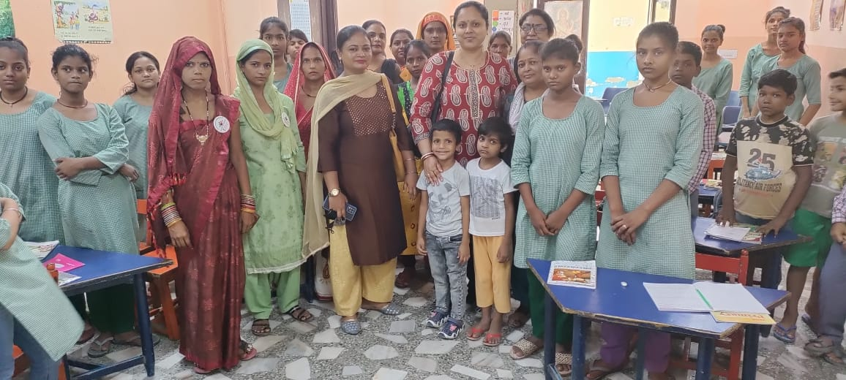
Prayas Juvenile Aid Centre - we sponsor the education of 100 girl children
(50 from the remand home & 50 from local community)
Approx. budget for 2022-23 = Rs 16.50 L
Visit to our CSR Partners

Slide 20
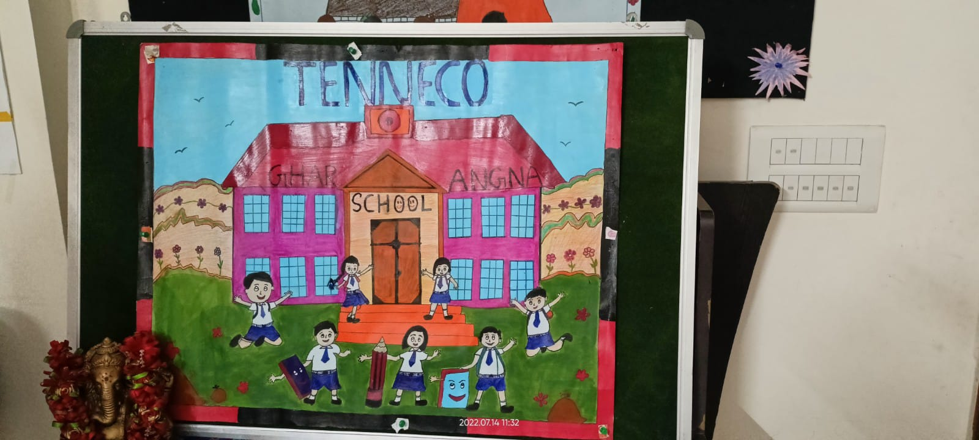
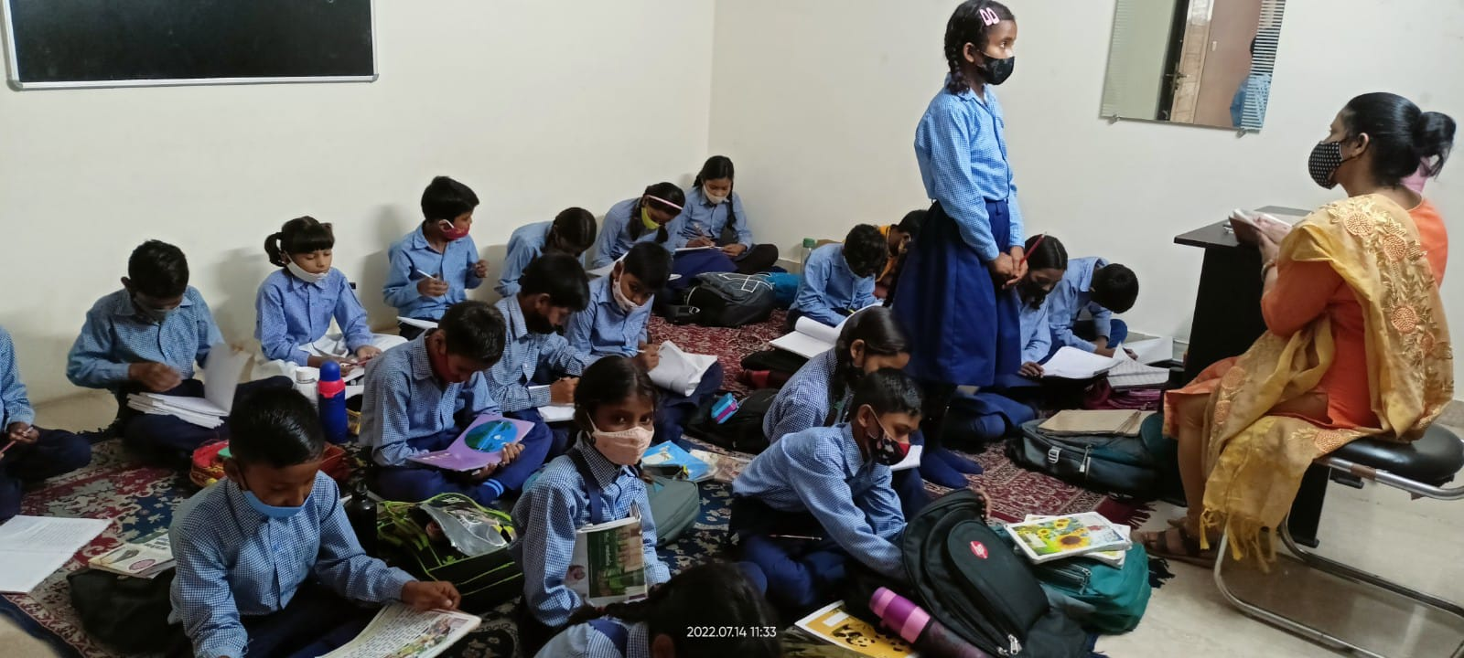
Ghar Angna – we sponsor the school completely for approx. 85 children (From local community)
Approx. budget for 2022-23 = Rs 10.25 L
Visit to our CSR Partners

Slide 21


